Slide 1
3.3
Types of business organisations

Slide 2
Types of organization
Retail outlet – Reliance Fresh, McDonald’s, Lifestyle
Manufacturing – Tata, Bajaj, L&T
Service – TCS, ICICI Bank, Apollo Hospitals
Government – NTPC, BHEL, BSNL, Indian Railways
NGO – Cry, Helpage India

Slide 3
Forms of ownership
Private sector –
Individual – Sole Proprietorship
Collective – Partnership/Company/Cooperative
Public sector – Company/ Corporation/ Department/Board
Joint sector

Slide 4
TYPES OF BUSINESS ORGANISATION

Slide 5
A. INDIVIDUALISTIC INSTITUTIONS
Individualistic institutions are established by a single individual or by a number of individuals.
1. Sole Trader
2. Joint Hindu Family
3. Partnership
4. Joint Stock company
5. Co-operatives
6. Multinational companies
7. Non-profit organizations

Slide 6
B. GOVERNMENT
Departmental Undertaking
Public Corporation
Government Company
Board organization

Slide 7
1. Sole Proprietorship
Business entity owned and operated by one person.
This is usually the least costly way of starting a business.
Members – Only owner
Ex- Hotels, Restaurants, Retail outlets
Merits – Simple & easy to start and exit, Quick decision making, undivided profits
Demerits – Unlimited liability, ltd. funds, uncertain life of business

Slide 8
A Refreshing Start: Coca Cola Owes its Origin to a Sole Proprietor!
The product that has given the world its best-known taste was born in Atlanta, Georgia, on May 8, 1886. Dr. John Stith Pemberton, a local pharmacist, produced the syrup for Coca-Cola®, and carried a jug of the new product down the street to Jacobs’ Pharmacy, where it was sampled, pronounced “excellent” and placed on sale for five cents a glass as a soda fountain drink. Dr. Pemberton never realised the potential of the beverage he created. He gradually sold portions of his business to various partners and, just prior to his death in 1888, sold his remaining interest in Coca-Cola to Asa G. Candler. An Atlantan with great business acumen, Mr. Candler proceeded to buy additional business rights and acquire complete control. On May 1, 1889, Asa Candler published a full-page advertisement in The Atlanta Journal, proclaiming his wholesale and retail drug business as “sole proprietors of Coca-Cola ... Delicious. Refreshing. Exhilarating. Invigorating.” Sole ownership, which Mr. Candler did not actually achieve until 1891, needed an investment of $ 2,300.
It was only in 1892 that Mr. Candler formed a company called The Coca-Cola Corporation.

Slide 9
2. Joint Hindu Family
A Joint Hindu Family comprises of father, mother, sons, daughters, grandsons and granddaughters.
They hold the property jointly. They do the business under the control of the head of the family.
The head of the family is known as ‘KARTA’.
These families have been engaged in occupations like agriculture, handicrafts, small industries etc.

Slide 10
Gender Equality in the Joint Hindu Family a Reality
With the introduction of the Hindu Succession (Amendment) Bill 2004 in Parliament on December 20, 2004, the Government has gone a step further in fulfilling its commitment towards gender equality made in National Common Minimum Programme (NCMP). The Bill to amend the Hindu Succession Act of 1956 gives women equal rights in the inheritance of ancestral wealth, something reserved only for male heirs earlier.
It, indeed, is a significant step in bringing the Hindu Law of inheritance in accord with the constitutional principle of equality.

Slide 11
3. Partnership
A partnership is an association between two or more persons who have agreed to operate a business.
Members – Minimum -2, Maximum - 20
Ex - & Sons, & Brothers
Merits – Easy formation, availability of funds, shared risk, shared wisdom & resources
Demerits – Unlimited liability, uncertain life of firm, distrust

Slide 12
Price Waterhouse Coopers was a Partnership Firm earlier
Price Waterhouse Coopers, one of the world’s top accountancy firms has been created in 1998 by the merger of two companies, Price Waterhouse and Coopers and Lybrand — each with historical roots going back some 150 years to the 19th century Great Britain. In 1850, Samuel Lowell Price set up his accounting business in London. In 1865, he was joined in partnership by William H. Holyland and Edwin Waterhouse. As the firm grew, qualified members of its professional staff were admitted to the partnership. By the late 1800s, Price Waterhouse had gained significant recognition as an accounting firm.

Slide 13
4. Joint stock company / a company (corporate)
A company is an association of persons formed for carrying out business activities and has a legal status independent of its members.
The company form of organization is governed by The Companies Act, 1956
The shareholders are the owners of the company while the Board of Directors is the chief managing body elected by the shareholders.
The capital of the company is divided into smaller parts called ‘shares’ which can be transferred freely from one shareholder to another person
Example - .inc (incorporated) follows the company name in USA
Ltd. in UK

Slide 14
types of companies
Types of Companies
Private Ltd. company
Sundaram Finance
Balaji Telefilms private ltd
Flipcart.com
Min. – 2
Max. - 50
Public Ltd. Company
Reliance Industries
HUL
Infosys
Min.- 7
Max. – Unlimited
Government
1. Public corporation
Air India
2. Board organisation
FCI, Khadi
3. Govt. company
ONGC, SAIL
3. Department
Telecom, Post

Slide 15
Tata group
The Tata group comprises over a 100 operating companies spread across six continents.
Information systems and communications, manufacturing, consumer & retail, financial services, services (airline, hotels) energy, consumer products, and chemicals, realty & infrastructure, defence & aerospace
The Group was founded by Jamsetji Tata in the last quarter of the 19th century - a period when India had just set out on the road to gaining independence from British rule.

Slide 16
infosys
Infosys started as a Private Limited Company in 1981, but in 1992 it re-registered as a Public Limited Company and launched IPO in 1993.

Slide 17
5. Co-operative society
A co-operative is a nonprofit, nonpolitical, nonreligious, voluntary organization, formed with economic objective
Members – At least 10 adults, no maximum limits
Ex – Indian Fertilizers and Farmers Cooperative (IFFCO), AMUL, Cooperative banks, Sugarcane Growers Cooperative Society
Merits – Promotes societal values, limited liability
Demerits – Fraudulent activities, limited resources

Slide 18
Amul’s amazing Cooperative ventures!
Every day Amul collects 4,47,000 litres of milk from 2.12 million farmers (many illiterate), converts the milk into branded, packaged products, and delivers goods worth Rs. 6 crore (Rs. 60 million) to over 5,00,000 retail outlets across the country. It all started in December 1946 with a group of farmers keen to free themselves from intermediaries, gain access to markets and thereby ensure maximum returns for their efforts. Based in the village of Anand, the Khera District Milk Cooperative Union (better known as Amul) expanded exponentially. It joined hands with other milk cooperatives, and the Gujarat network now covers 2.12 million farmers, 10,411 village level milk collection centres and fourteen district level plants (unions).

Slide 19
Amul is the common brand for most product categories produced by various unions: liquid milk, milk powder, butter, ghee, cheese, cocoa products, sweets, ice-cream and condensed milk. Amul’s sub-brands include variants such as Amulspray, Amulspree, Amulya and Nutramul.
The edible oil products are grouped around Dhara and Lokdhara, mineral water is sold under the Jal Dhara brand while fruit drinks bear the name Safal.

Slide 20
6. Multinational Companies (MNC’s)
A multinational company may be defined as a company that operates in several countries.
Such a company has factories, branches and located in more than one country.
Example – HUL, Coca Cola
Visa > Zimbabwe
E bay > Madagaskar
Walmart > Norway

Slide 21
Indian companies in top 500 - 2016
Indian Oil – 161rank
Rajesh Exports – Gems & Jewelry – 423 rank
Reliance Industries - 215
State Bank of India - 232
Bharat Petroleum - 358
Hindustan Petroleum - 367
Tata Motors - 226

Slide 22
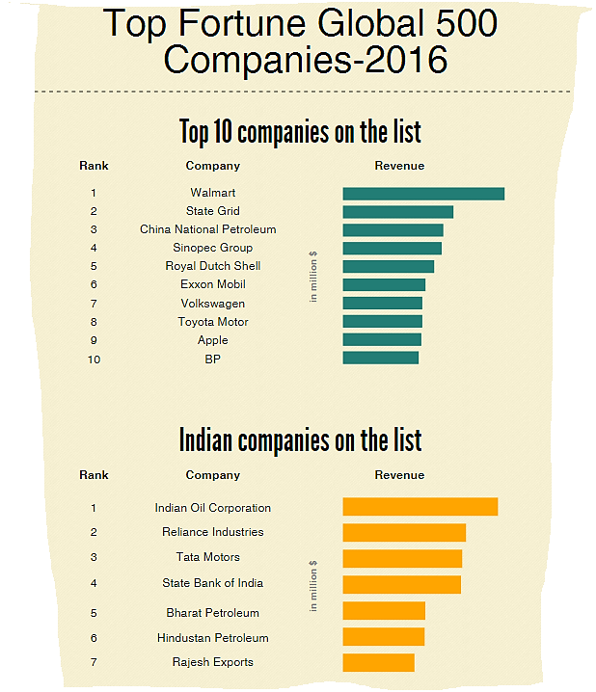

Slide 23
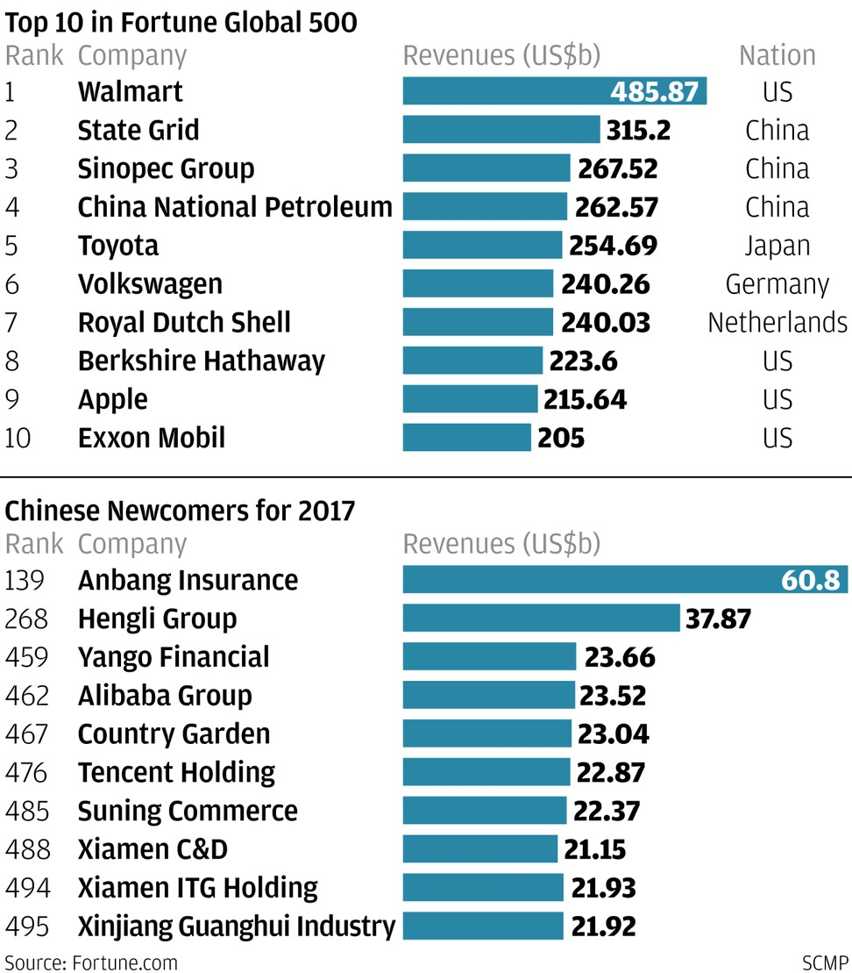
Companies in top 500 - 2017

Slide 24
Indian mnc’s
Tata Steel
Reliance Industries
Hindalco
Sun Pharma
Wockhardt
Patni Computers
Dr. Reddy’s
Bharat Forge
Wipro
Infosys
Videocon

Slide 25
7. Non-Profit Organizations
Non-profit organisation can be classified into public organisations and private sector organisations.
Some organisations created by the Government in the public sector are directed towards meeting the basic needs of the people.
Many private sector organisation are created by socially oriented people with a view to meet certain unmet needs of the society.
In both these cases profit-making is not a goal.
Example – Red cross

Slide 26
B. GOVERNMENT INSTITUTIONS
Public sector enterprises are those enterprises which are owned, controlled and operated by the central or state government or by both.
Example - Iron and steel electronics, ships, aviation, locomotives, heavy machinery, fertilisers, chemicals, insecticides, drugs.

Slide 27
1. Departmental Undertaking
This is considered as a department attached to the ministry of a government.
Railways, postal, B.S.N.L., broad casters like Doordarshan are the examples of Departmental Undertakings.

Slide 28
2. Public Corporation
This is established under a specific statute passed in the parliament. It is known as a statutory corporation because it is created by a statute.
Reserve Bank of India, Air India, IDBI, Life Insurance Corporation and Unit Trust of India are the examples of public corporation.

Slide 29
3. Government Company
Government Company is also established under the Companies Act of 1956.
It is a company in which not less than 51% of paid up share capital is held by the central government or by one or more state governments or jointly by the central and state governments.
Hindustan Steel Limited, Bharat Heavy Electricals Limited, ONGC, SAIL are the examples of Government Company.

Slide 30
Holding company and subsidiary company
If company A holds more than 50% Shares of company B then, Company A is a holding company and Company B is a subsidiary company.
Coal India is a holding company. Bharat Coking ltd, Mahanadi Coal Fields ltd are its subsidiary companies.
Similarly, Konkan Railway is a subsidiary company of Indian Railways. Although Indian Railways is not a ‘Holding Company’, it is a Departmental undertaking.

Slide 31
4. Board Organisation
In this organisation management is carried on by a government nominated independent Board.
Tamil Nadu Electricity Board, Tamil Nadu Housing Board, Tamil Nadu Water and Drainage Board are the examples of Board Organisation.

Slide 32
Identify type of business organisation
A group of programmers in India plan to start a software company and sell stock to other investors.
A person in Jaipur who creates small home decorations as a hobby plans to start selling these items
Three doctors in Gurgaon wish to share office, staff and equipment
Three friends are opening a small store to sell sports equipment

Slide 33
Answers
Corporation : Public ltd.
Sole proprietorship
Partnership
Partnership

Slide 34
Review question
For which of the following types of business do you think a sole proprietorship form of organisation would be more suitable, and why?
Grocery store
Medical store
Legal consultancy
Craft centre
Internet café
Chartered accountancy firm.

